Slide 1

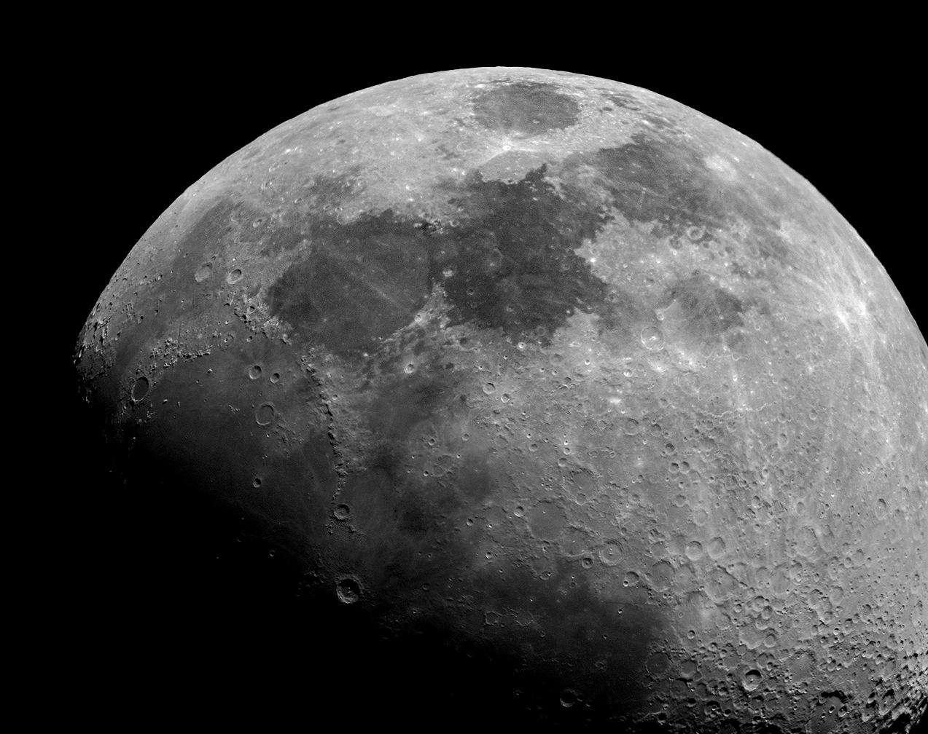
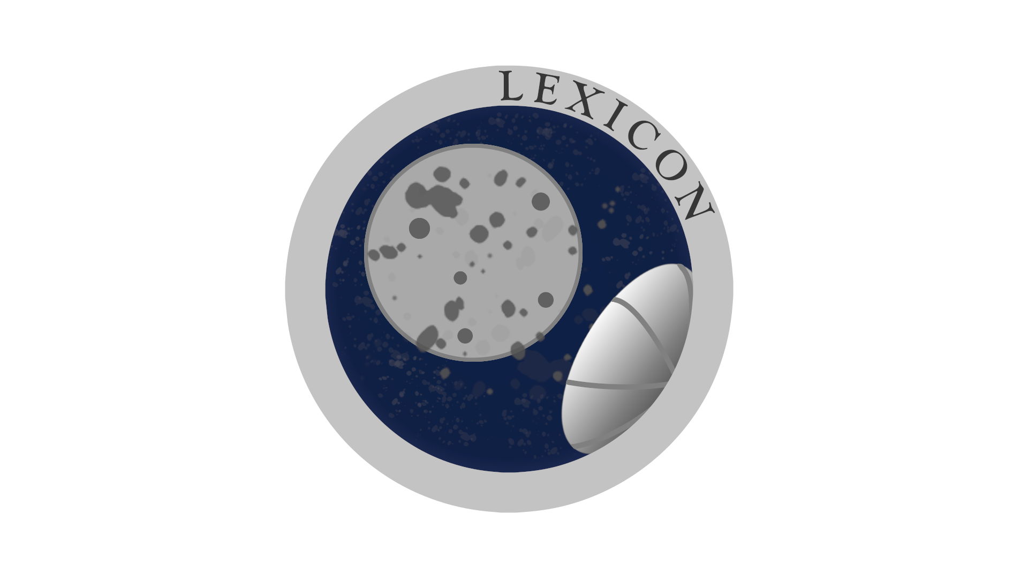
LEXICON
Lunar EXtraction In a Closed envirONment

Slide 2
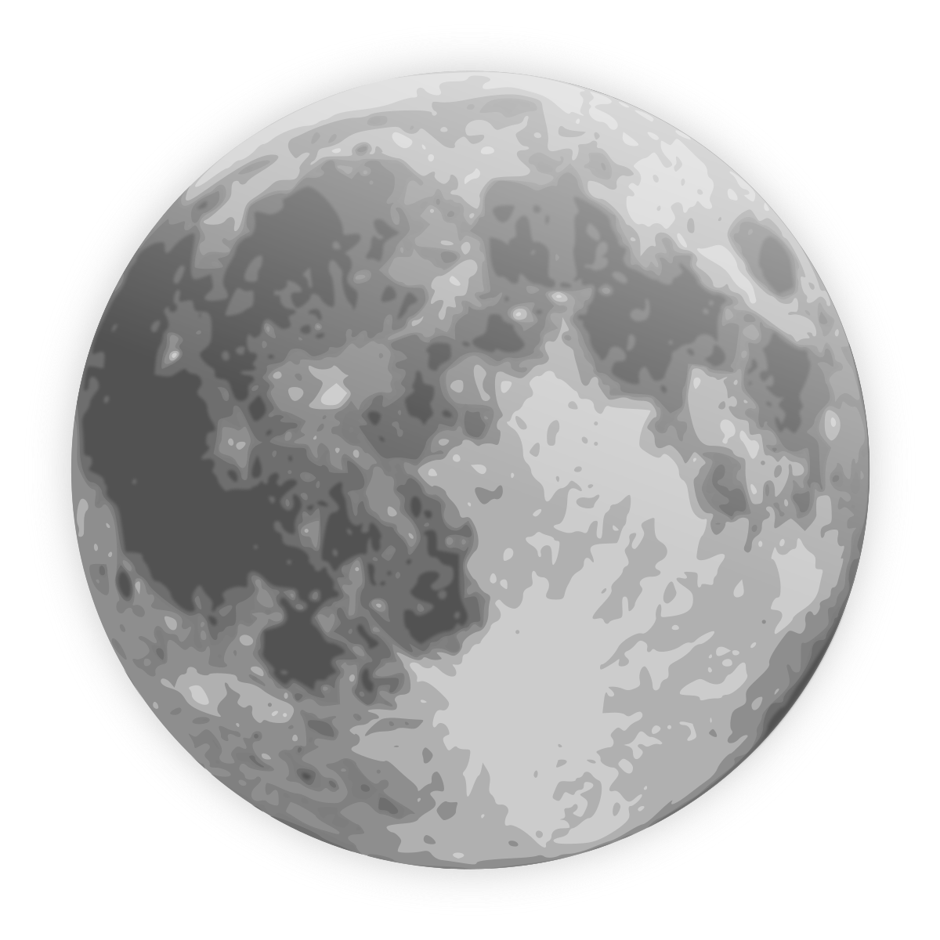
Outline
Motivation & Problem Statement
1
Mission Environment
2
Mission Architecture
3
Costs Analysis
4
Risk Analysis
5
Timeline
6

Slide 3
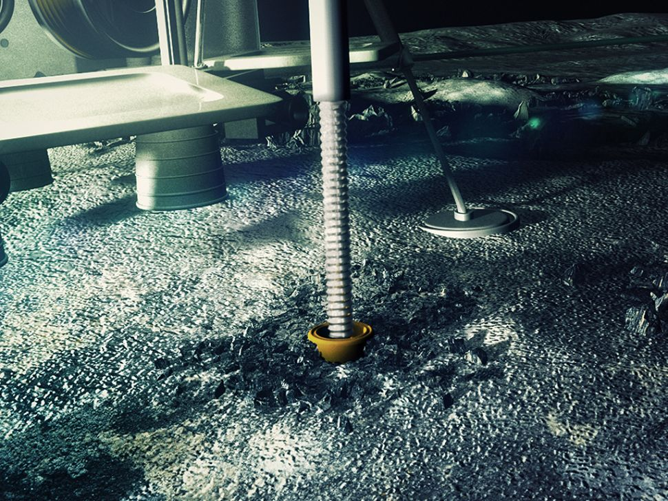
Motivation
Problem Statement
  Water extraction can create a hefty amount of dust and which poses a carcinogenic hazard, as well as an existential threat to engineered systems
Motivational Statement
  Water drilling excavation near habitat
  Collection of dust for future uses to extract minerals (Si, Al, Mg etc.) for ISRU
  Avoid waste of solid water mixed with the regolith
  Collection of Lunar Regolith due to excavation process.
Credits: Rawcut Television/Lunar Mission One

Slide 4
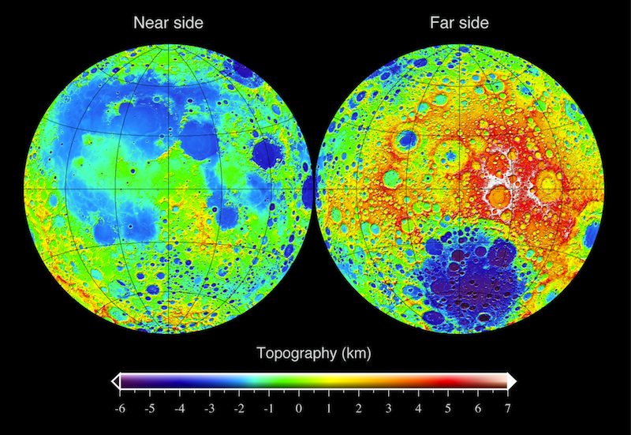
Lunar Surface Composition
Two primary geological terrains → Maris, Highlands
Dominant Materials → Anorthite, Orthopyroxene, Olivine, Ilmenite
Compounds | Composition (wt%)
 | Maris | Highlands
Silica (SiO₂) | 45.4 | 45.5
Aluminium (Al₂O₃) | 14.9 | 24.0
Lime (CaO) | 11.8 | 15.9
Iron Oxide (FeO) | 14.1 | 5.9
Magnesia (MgO) | 9.2 | 7.5
Titanium dioxide (TiO₂) | 3.9 | 0.6
Sodium oxide (Na₂O₂) | 0.6 | 0.6
Blue: Anorthositic Highlands | Yellow: Low-Ti basalts
Red: High-Ti basalts | Greenish: Fe-rich
Taylor, Stuart R. (1975). Lunar Science: a Post-Apollo View.
Oxford: Pergamon Press. p. 64. ISBN 978-0-08-018274-2
Source: https://doi.org/10.2138/rmg.2006.60.3
Notes:
https://pubs.geoscienceworld.org/msa/rimg/article-abstract/60/1/221/140775/The-Constitution-and-Structure-of-the-Lunar?redirectedFrom=fulltext
2. highlands: the lighter, heavily cratered regions of the Moon, which are generally several kilometers higher than the maria
3. mare: (plural: maria) Latin for “sea;” the name applied to the dark, relatively smooth features that cover 17% of the Moon’s surface

Slide 5
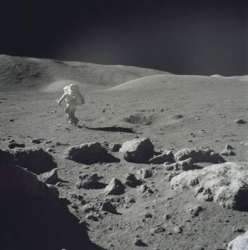
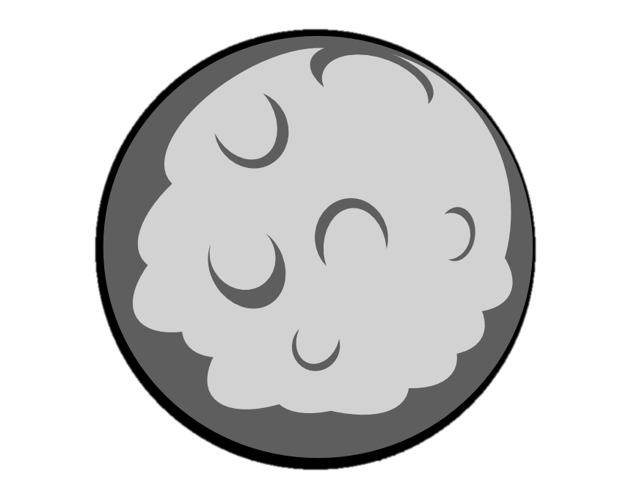
Mission Environment
Extreme changes in temperature
Near vacuum pressure
Constant exposure to radiation
Ultrafine dust particles
Moon dust and regolith
Credits: NASA
Notes:
Extreme changes in temperature – material needs to sustain those changes
Constant exposure to radiation – the equipment must be protected so radiation doesn't damage it
Ultrafine dust particles – must strong enough not to be damaged by razor sharp dust particles
Near vacuum pressure – must be able to work efficiently in vacuum on the lunar surface

Slide 6
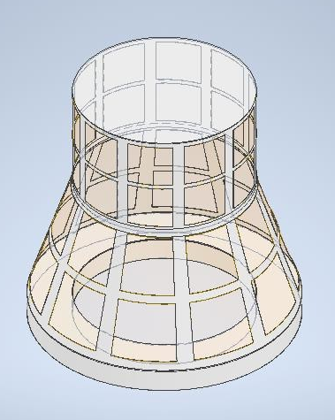
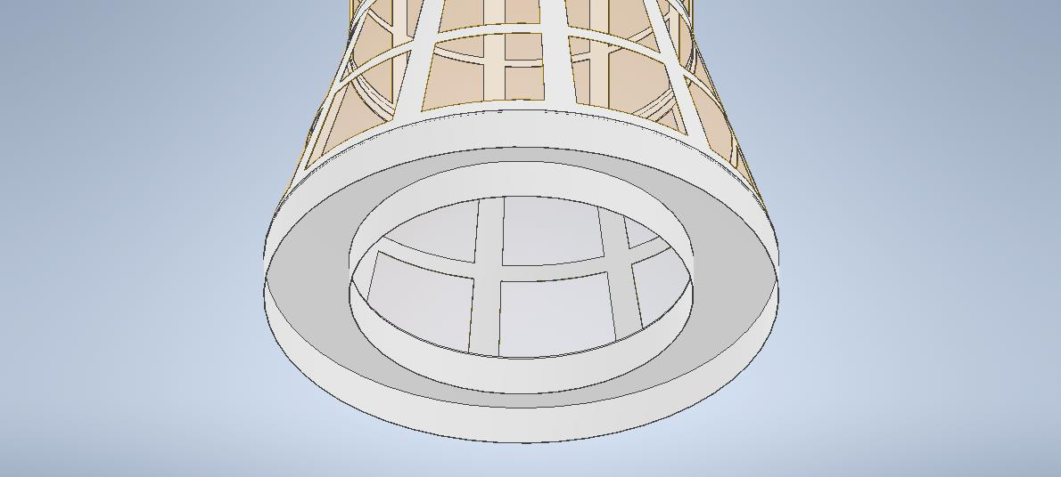
Mission Architecture - Key features
Funnel shaped dome to be pressurized
Materials: ABS (skeleton) & Kevlar (coating)
Gross size: 1.2m (outer diameter)
      0.8m (inner diameter)
      1.8m (height)
Thickness: 3mm lateral skeleton
      5mm top and bottom coverage
Weight: 8.6 kg
Double bladed base
180 cm
80 cm
120 cm
LEXICON dome: double-bladed base detail
LEXICON dome: gross size

Slide 7
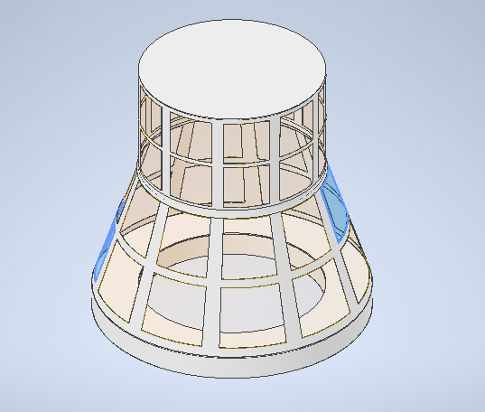
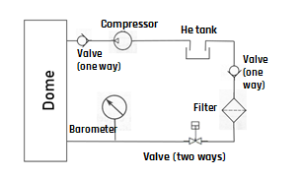
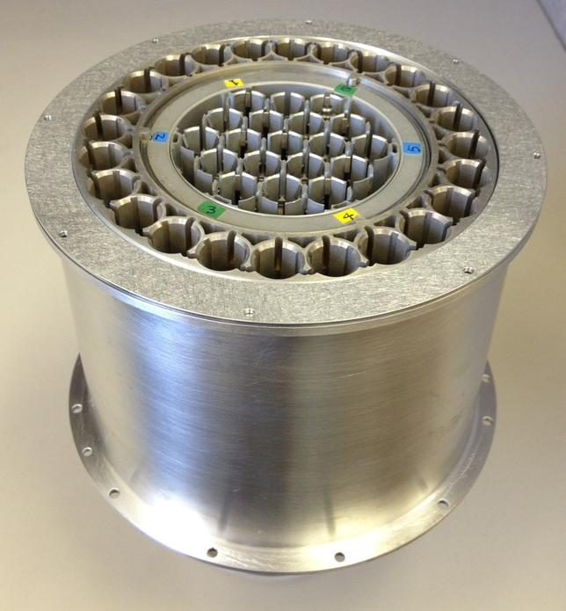
Mission ConOps
Chamber Pressurizing
Water extraction
Natural vacuuming the chamber and extracting the dust
Filtering the vacuumed gas and storing the dust in the capsules
Feed back the gas into the chamber
Inside Filter
Sample Caching System
Credits: NASA

Slide 8
Costs Analysis
BC: Building Components | Units | $/Unit | Costs
Material for Structure (QTY: Per KG) | 3.0 | €17.99 | €17.99
3D Printing Service | 1.0 | €200.00 | €50.00
Fabric for Inflatable dome cover (QTY: Per Meter) | 10.0 | €10.00 | €20.00
Plastic(PVC) pipe for gas/dust (QTY: Per Meter) | 10.0 | €0.50 | €10.00
One way valves | 5.0 | €5.00 | €10.00
Shape memory foam | 1.0 | €100.00 | €50.00
Filter (10/20/50 micrometer) | 15.0 | €15.00 | €75.00
Chinese Flex Tape | 1.0 | €2.00 | €2.00
Barometer/thermometer | 2.0 | €14.00 | €14.00
Micro Compressor | 2.0 | €12.00 | €12.00
Dust particle measuring device | 1.0 | €150.00 | €150.00
High Fidelity Regolith Simulant | 1.0 | €21.45 | €21.45
Li Battery | 3.0 | €10.00 | €30.00
Power Socket | 1.0 | €10.00 | €10.00
Additional Cost | 1.0 | €300.00 | €300.00

Slide 9
Risk Analysis
ID | Risk | Mitigation action | Severity Index* (1-5) | Likelihood index** (1-5) | Risk Index
LEX-R-01 | Leakage of the pipeline | Chinese flex tape to block the area | 5 | 3 | 15
LEX-R-02 | Pipeline flux blockage | Deconstruction and unblocking of the tube followed by fitting it back | 4 | 1 | 4
LEX-R-03 | Main chamber structure damage | Minor fixing/reconstruction | 5 | 3 | 15
LEX-R-04 | Fabric damage (if any) | Chinese flex tape to block the area | 5 | 3 | 15
LEX-R-05 | Failure of the carousel | Reconstruction | 4 | 2 | 8
LEX-R-06 | Pipeline damage by regolith | Minor fixing | 3 | 1 | 3
LEX-R-07 | Damage of filter | Change of filter manually | 5 | 2 | 10
LEX-R-08 | Failure of the compressor | Repair of the compressor | 3 | 2 | 6
LEX-R-09 | Blower failure | Replacement of the blower with a reserve blower | 3 | 2 | 6
LEX-R-10 | Sensors failure | Replacement of the sensor | 2 | 3 | 6
LEX-R-11 | Money | Investment & Sponsorship | 5 | 5 | 25
LEX-R-12 | Blades failure | Change the blades manually | 4 | 2 | 8
LEX-R-13 | Valves damage | Replace it manually | 5 | 2 | 10
LEX-R-14 | Short circuit in power socket | Substitute with a portable battery power station | 5 | 3 | 15
LEX-R-15 | Damage of shape memory foam | Minor fixing using flex tape | 4 | 3 | 12

Slide 10

Timeline
24/07/2020
EPFL Asclepios Hackathon Winner Team
Start of the fundraising campaign
Materials Gathering
Phase-A Definition
Experiment procedures assessment
Towards Asclepios I astronauts’ training
Facility Search & Prototyping
15/09
06/10
01/11
06/11
05/12
Fundraising Campaign

Slide 11




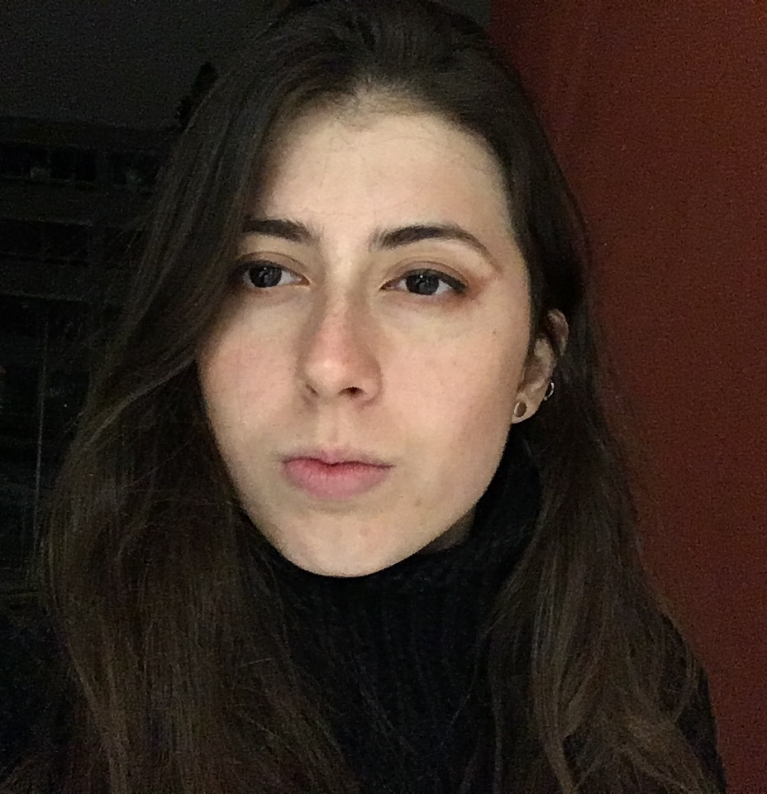
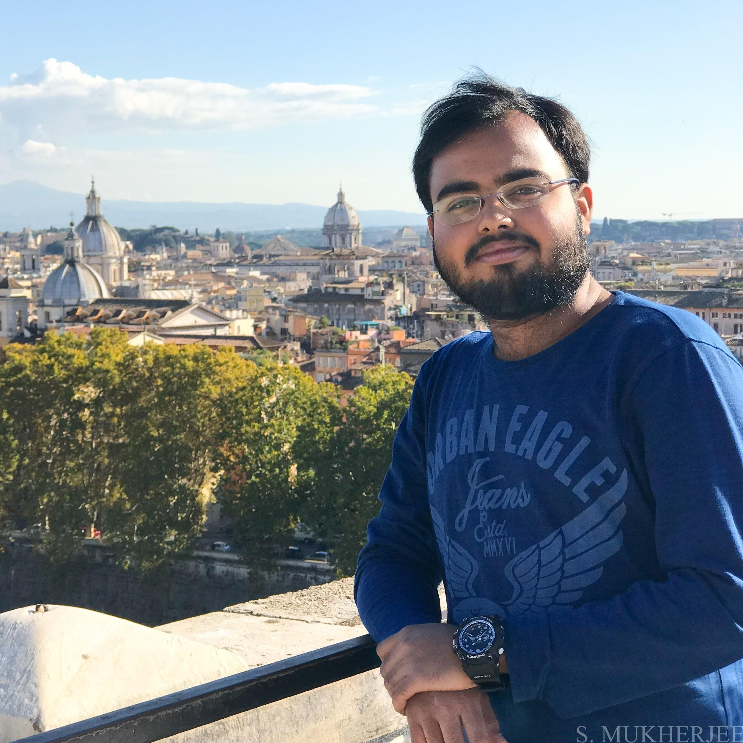
Team work makes best work
Purichmun Low
Aerospace Engineer
Francesco Ventre
Space Engineer
Bruno Pavletić
Molecular Biologist
Vahid Nateghi
Space Engineer
Amanda Sánchez Magris
Aerospace Engineer
Swarnajyoti Mukherjee
Space Engineer

Slide 12
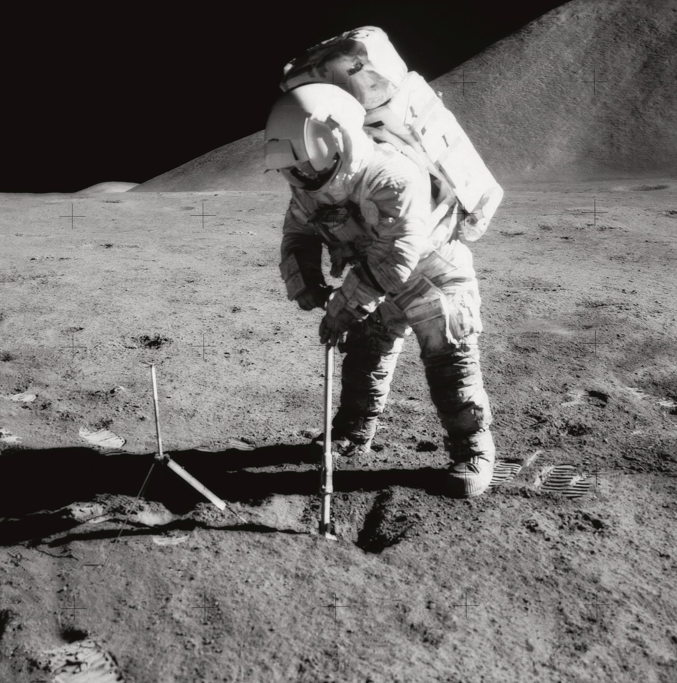
THANK YOU FOR YOUR ATTENTION
If you have any questions please reach us at:
francesco.ventre@mail.polimi.it
swarnajyoti.mukherjee@mail.polimi.it
vahid.nateghi@mail.polimi.it
amandasanchezm@gmail.com
purichmunlow123@gmail.com
bruno.pavletic@gmail.com

